Slide 1
All about my new school
Ormskirk C of E Primary.

Slide 2


All About My New School
Ormskirk C of E Primary School

Slide 3
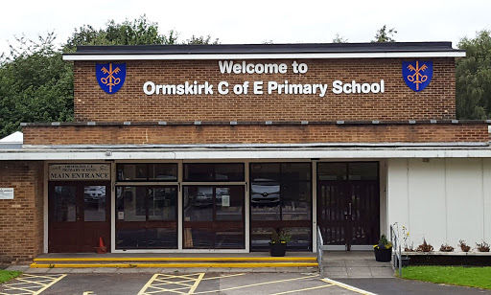
Your New School
This is your new school. It is called Ormskirk C of E Primary School. We are really pleased that you are going to join us.

Slide 4
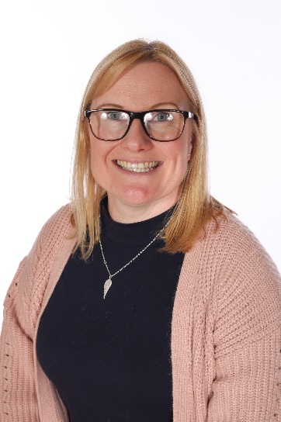
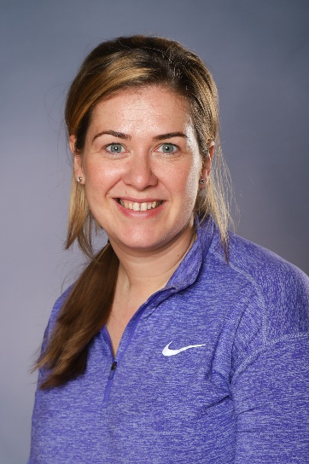
Meet Your Teacher
Hello. We will be your new teachers.
Our class is called
RC.
We are going to have lots of fun at school and make lots of new friends.
Miss Cocks
Mrs Monks

Slide 5
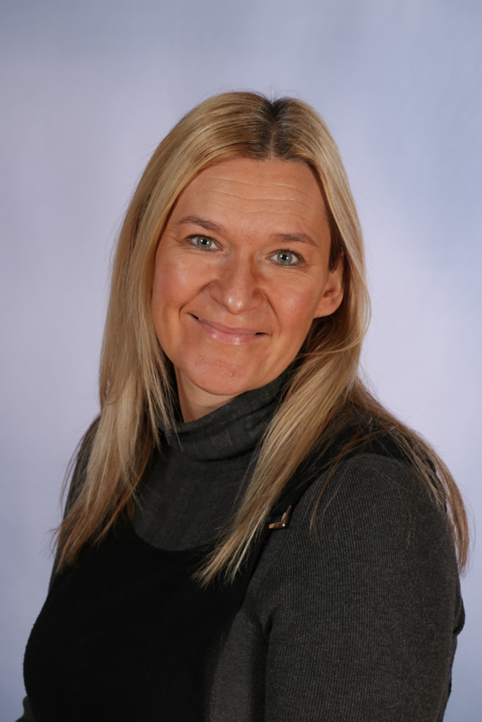
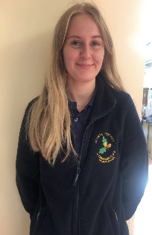
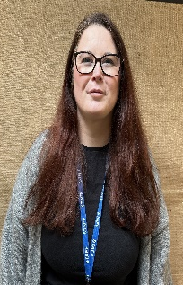
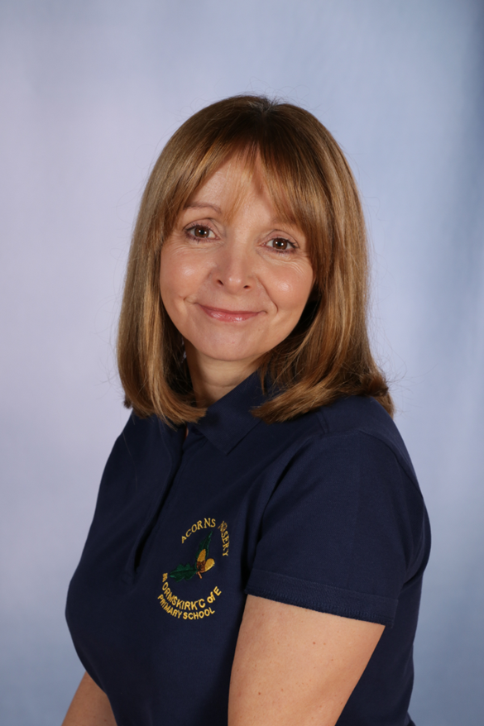
Meet the Team
There are lots of other people in school that can’t wait to meet you.
Here are a few people you will meet at school.
My name is Mrs Reeves and I am the other Reception Class Teacher.
My name is Miss Neill and I am an Early Years Apprentice.
My name is Mrs Bullock and I am a Teaching Assistant.
My name is Mrs Brady and I am a Teaching Assistant.

Slide 6
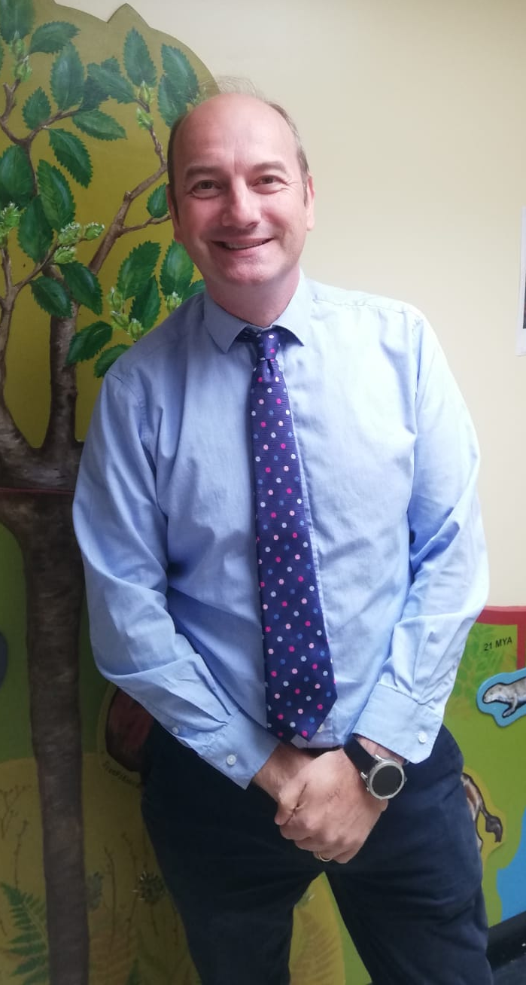
Meet Your Headteacher
My name is Mr Storch and I will be your headteacher. When you start school, I will come and say hello and look at the lovely work and playing you are doing.

Slide 7
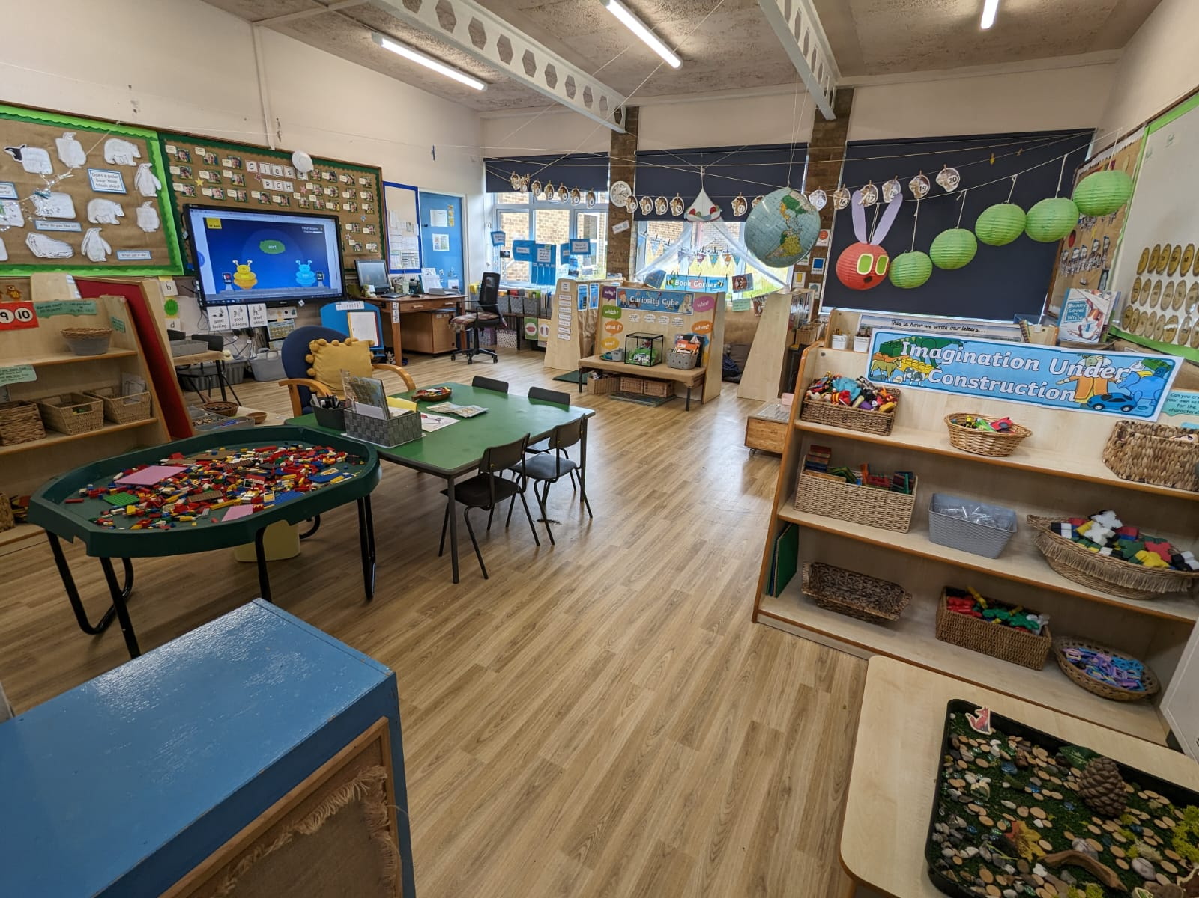


Your New Classroom
This is our classroom. There are lots of lovely things to do. You might like to play with the toys, read a book and draw a picture.

Slide 8
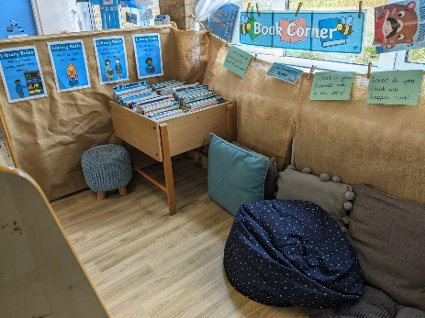
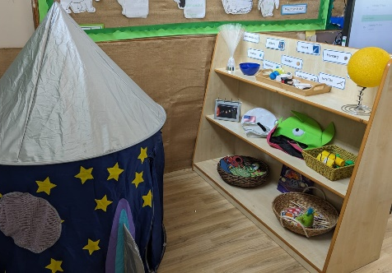


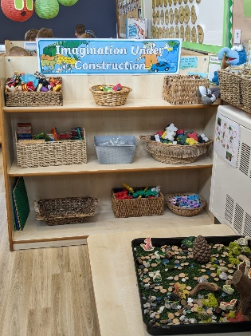
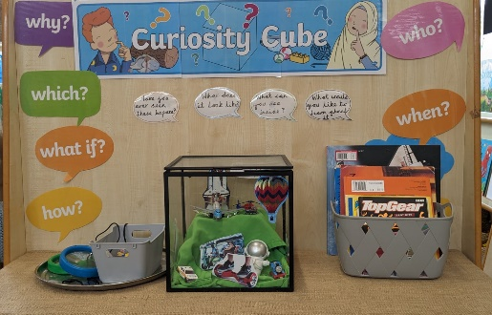
Some Lovely Activities We Do in Our Class
There are lots of things to play with. What do you think you will do first?

Slide 9
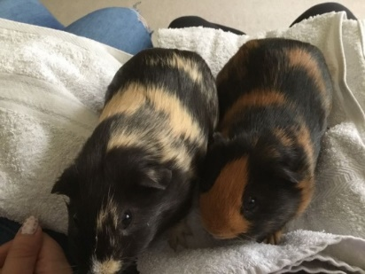
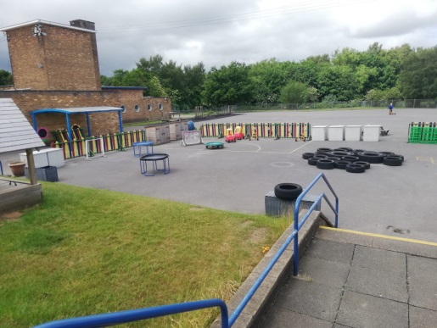
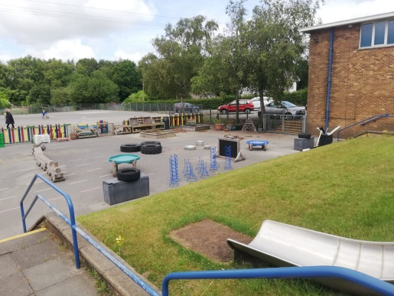
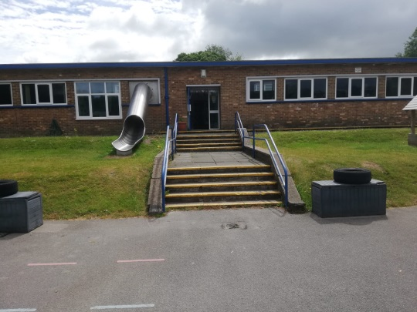
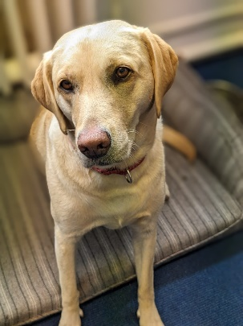
The Outside Area
We also have a lovely outside area for you to play in.
Look at all the wonderful things to do.
This is our school dog. She is called Pebbles.

Slide 10
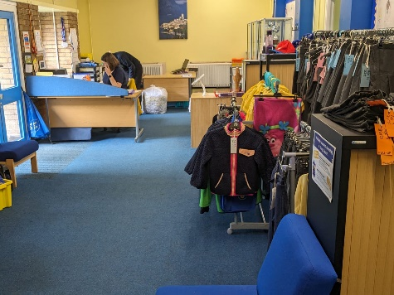
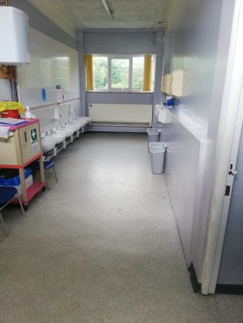
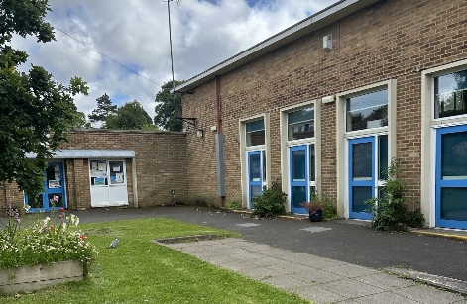
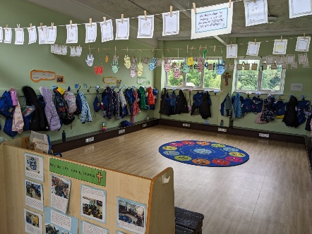
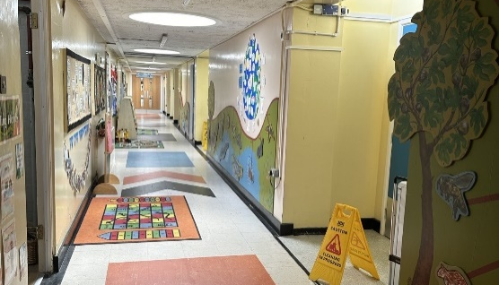
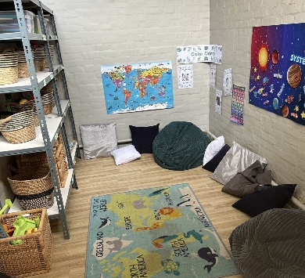
Let’s Have a Look Around School
There are lots of other places in school that we can explore together.
Here are a few that we will visit and use.
Reception’s entrance
the pupil office
the toilets
the cloakroom
the corridor
the rainbow room

Slide 11
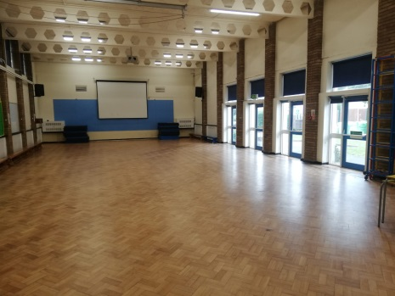
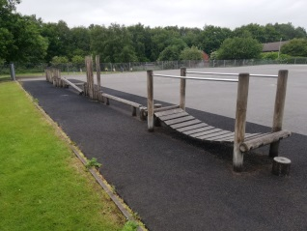
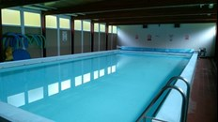
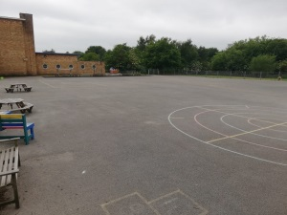
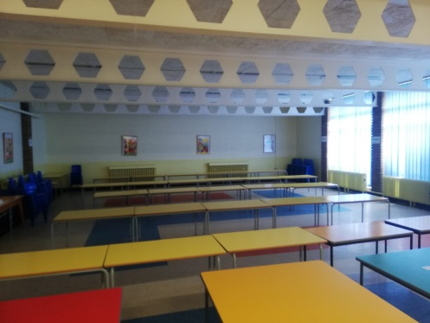
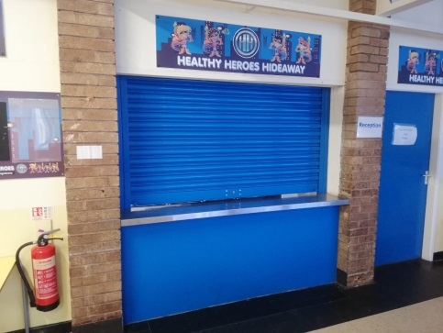
Let’s Have a Look Around School
There are lots of other places in school that we can explore together.
Here are a few that we will visit and use.
the sports hall
the infant playground
the swimming pool
the dinner hall
the dinner hall hatch

Slide 12

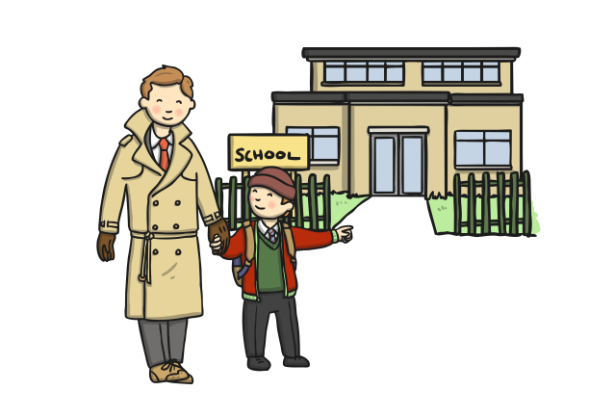

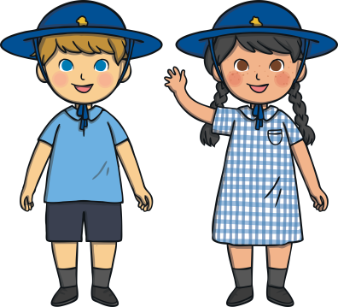
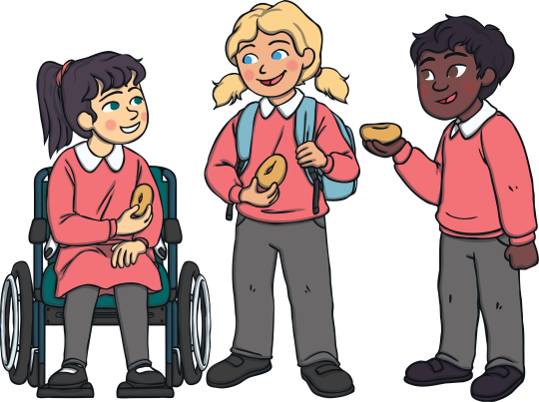

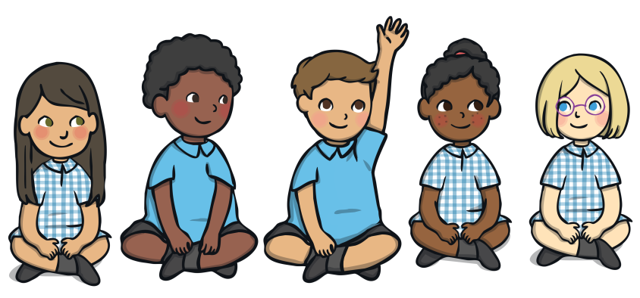
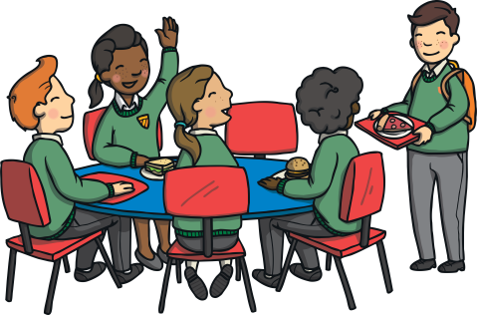

We can’t wait to meet you. Have a lovely summer and stay safe!
See you soon!

