Slide 1
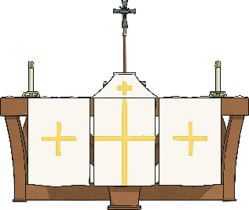
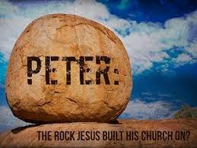
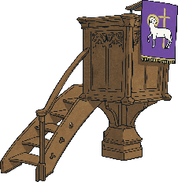
Are all churches the same?
Key Vocabulary
denomination | A recognised branch of the Christian Church e.g. Catholic, Anglican, Methodist.
sacrament | Sacraments are rituals that teach, strengthen and express faith through which God can communicate His grace to an individual.
Eucharist | One of the seven sacraments. The sacrament of the Eucharist is when Christians remember the Last Supper.
Baptism | One of the seven sacraments. Christians believe that baptising cleanses people from original sin and marks a person’s official entry into the Church.
congregation | The people who come to church services are called the congregation.
service | The act of communal (collective) worship, using in a place of worship.
hospitality | The friendly and generous welcoming of others.
Features of churches
Churches of different denominations and in different countries don’t all look the same. However, these are some of the features you might see inside.
Altar – the table at the very front of the church which holds the bread and wine for the Eucharist.
Font – This is where part of the Baptism service takes place. The font holds holy water.
Pews – Some churches have pews (long wooden benches) where the congregation sits. Other churches have chairs.
Lectern – Where the Bible sits. Readings are read from here during a service.
Pulpit – A raised platform from which the church leader can teach from the Bible.
Candle - To represent that Jesus is the light of the world.
What is a ‘church’?
The church is the people and not the building. It is one body of people all working together to share the good news and build the kingdom of God. Jesus said to Peter that he was the rock on which He would build His church (Matthew 16:18).
What the Bible says about how the church should behave (Romans 12).
Humility: “Do not think of yourself more highly than you ought.”
Love: “Love must be sincere.”
Friendship: “Be devoted to one another.”
“Be joyful, patient, faithful.”
Peace: “Live in harmony.”
Compassion: “Practice hospitality.”
Forgiveness: “Overcome evil with good.”

