Slide 1
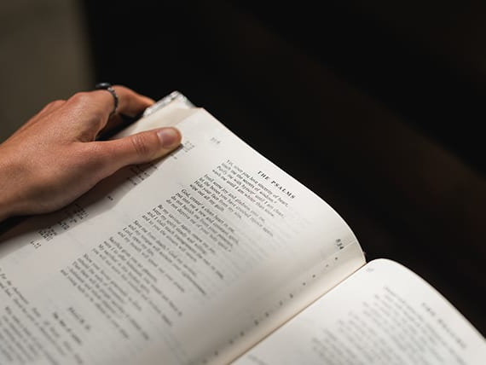
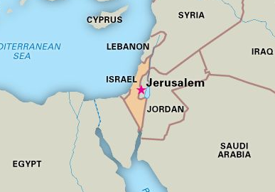
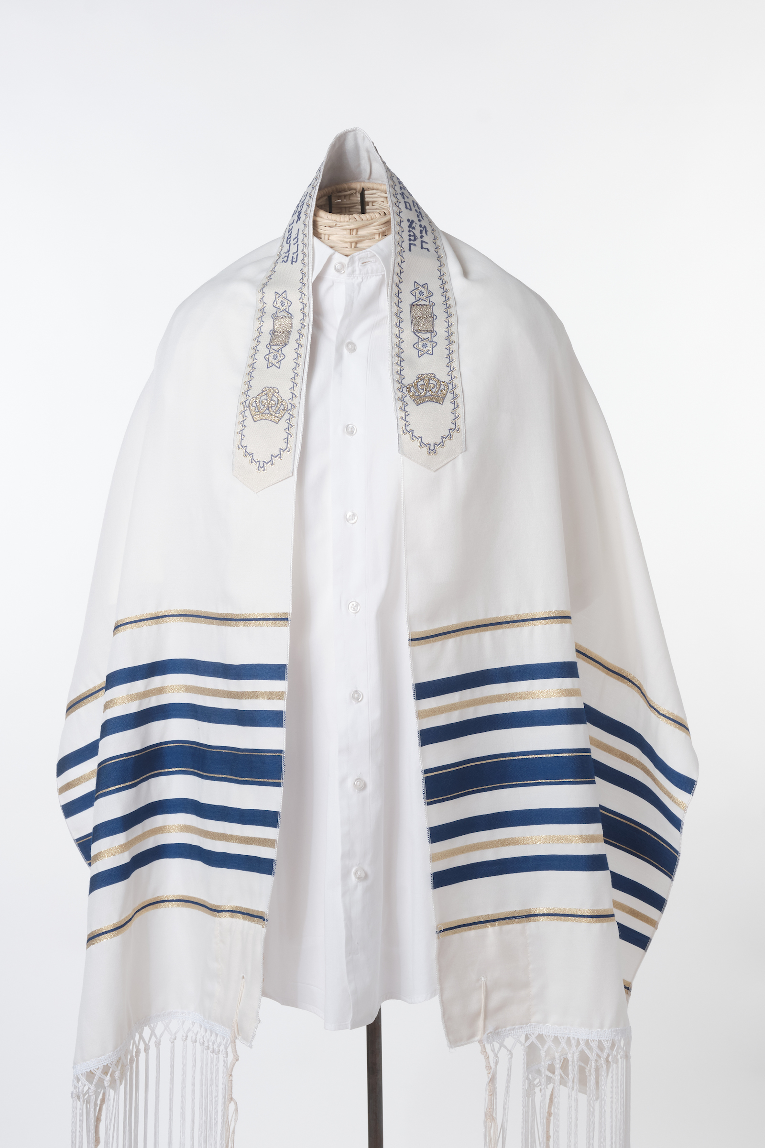
R.E.: What is prayer?
Key Vocabulary
pray | To communicate with God (verb).
prayer | An act of worship that is like having a conversation with God (noun).
Amen | Exclamation said at the end of a prayer, meaning ‘so be it’ or ‘truth’.
communication | A two-way process involving the sharing and receiving of information.
gratitude | The quality of being thankful.
intercession | A prayer said on behalf of someone else.
Psalm | A sacred poem or song, found in the centre of the Bible.
Key Knowledge
Prayer is communication with God that helps to build a relationship with him. Prayer can be praise, intercession, thanksgiving, confession, silence, meditation or simply talking with God.
Prayer can be planned or spontaneous, loud or quiet, fun or serious. It is simply an expression of belief and commitment.
Key Vocabulary
Judaism | The religion followed by Jewish people. Jews believe that there is only one God. Jews promise to obey God’s laws to say thank you to Him for looking after them.
rabbi | The religious leader. Rabbi means ‘Teacher’ in Hebrew.
tallit | A blue and white, fringed prayer shawl.
Jewish law instructs Jews to pray towards Jerusalem.
Men traditionally wear a fringed prayer shawl called a tallit during the ritual morning prayer. Jewish women keep their heads covered.
Jewish men and women pray throughout the day, using prayers from the Psalms and from prayer books written by rabbis. They believe that when praying, you should do it with total concentration on God – there should be nothing else in your mind. The prayer should be completely from the heart.

