Slide 1
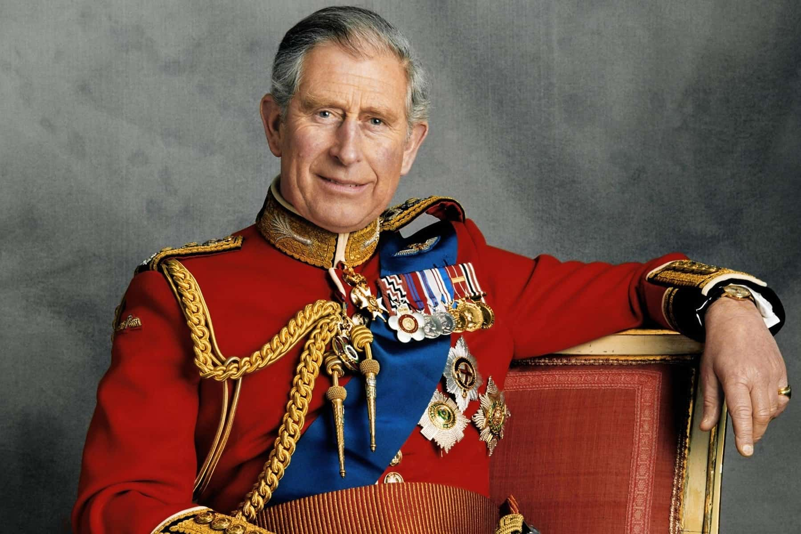
Kings And Queens
Key Vocabulary
Monarch | A person who reigns over a kingdom or empire: such as a king or queen.
Parliament | The lawmaking group in the government of the United Kingdom.
The Golden Age | A time of great exploration; a time when music poetry and literature flourished and when London opened its first theatres.
Reign | To rule as monarch.
Succession | The order the monarch’s family will take over the throne.
Monarch | Date | Most famous for…
William the Conqueror | 1066-1087 | His invasion of England and the battle of Hastings
Henry VIII | 1509-1547 | Having 6 wives and the establishment of the Church of England.
Elizabeth I | 1558-1603 | Being a strong female leader in the ‘Golden Age’ of Britain.
Queen Victoria | 1837-1901 | Having the second longest reign in British history. For having 9 children and devoted to her husband, Prince Albert.
Queen Elizabeth II | 1952-2022 | Having the longest reign of any British monarch. For adapting to the will of the people.
Text
Text
Our current monarch is King Charles. He became King on the 8th September 2022. King Charles has taken a keen interest in all areas of public life and has established more than 20 charities.

