Slide 1
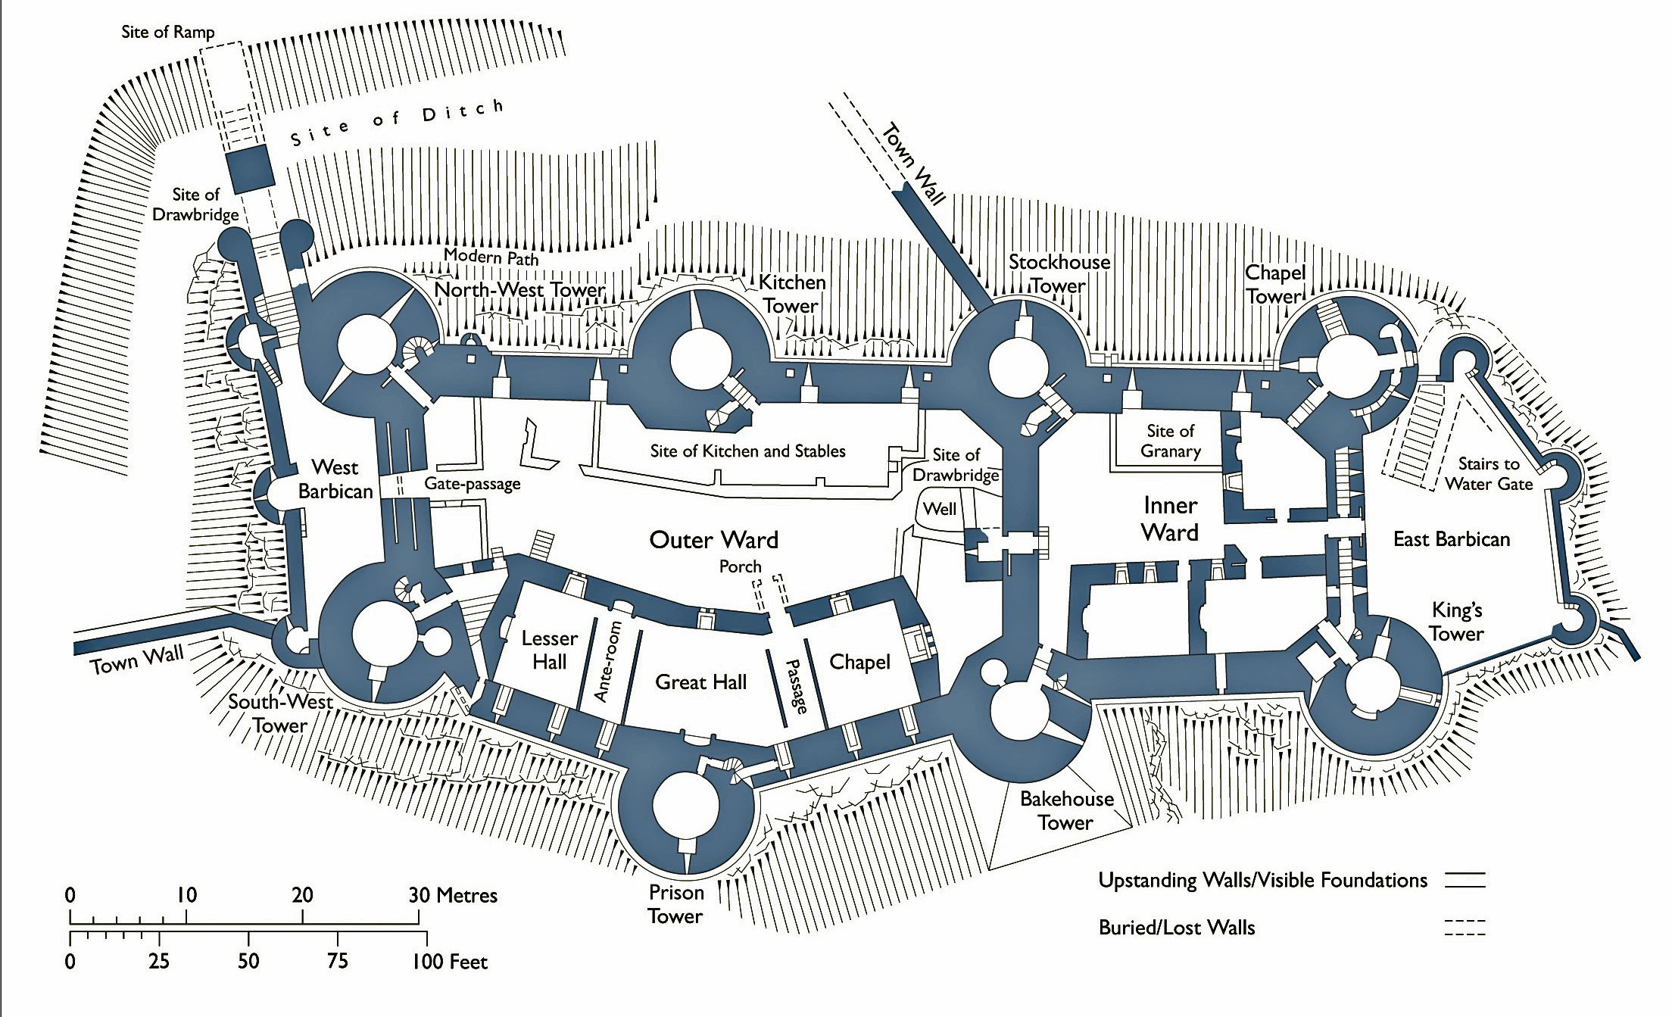
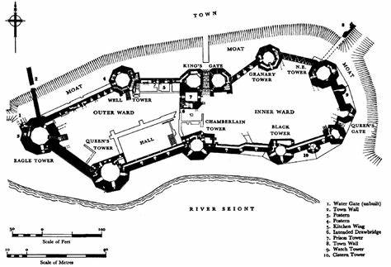
Castles
Key Vocabulary
Arrow loops | Small, slit-like windows which allowed anyone inside to shoot arrows at enemies while protecting themselves.
Battlements | The square-shaped part of the wall at the top of a castle.
Barbican | A section of wall which jutted out of the gateway which protected the entrance to the castle.
Portcullis | A heavy gate made from metal.
Bailey | An area within a castle wall.
Drawbridge | A bridge that can be moved to stop or allow passage across it.
Conwy Castle
Caernarfon Castle

